Slide 1

offtopics.in
IT Off-Topics
Explore beyond the ordinary with us

Slide 2

Introduction
IT Off-Topics is designed as your ultimate resource for everything related to IT and CS.
Here, you'll have the opportunity to engage in discussions about a wide range of topics that extend beyond the confines of traditional academic subjects.

Slide 3
Key Features Overview
Off-Topics Discussion
Academic Stuff
Student Hub
Open Source

Slide 4

Let's Know
IT Off-Topics Features in Full Explanation

Slide 5
1st
Off-Topics Discussion

Slide 6


01
Open Problems
02
Community & Resources
OT Discussion
03
Support & Solutions
04
Authorization

Slide 7
2nd
Off-Topics Open Source
Partially Open Source

Slide 8




OT Open Source
Share Innovative Ideas
Contribute Valuable Content
Enhance Your Resume
Showcase Your Expertise
Submit fresh concepts and suggestions to improve the Off-topics experience.
Provide articles, tutorials, and materials to keep the platform relevant and informative.
Boost your resume by showcasing your contributions to IT Off-topics projects.
Demonstrate your skills and knowledge through active participation and content creation.

Slide 9
3rd
OT Academic Stuff

Slide 10

01
Streamlined Timetable Display
02
Blogs and Updates Subscription
OT
Academic Stuff
03
Simplified Syllabus and Notes Access
04
Student Hub

Slide 11
Streamlined Timetable Display
You can see the timetable for only the specific day you want to view. This means you don’t have to do anything, as the timetable automatically updates according to the day.

Slide 12
Blogs and Updates Subscription
Stay updated with the latest news, articles, and feature updates by subscribing or filling to our Forms.

Slide 13
Simplified Syllabus and Notes Access
IT Off-Topics has arranged the syllabus so that students feel good just by looking at it. We’ve added the syllabus with a new user interface, making it easy for students to access.

Slide 14
Student Hub
It is a student collection group where we showcase the basic details of every student.
This feature is here to let students know about each other’s activities. Top performers and students can easily help and give suggestions to each other.
This will bring top performers into the spotlight, making them feel proud, and others can appreciate them.

Slide 15
Advantages and Impact
IT Off-Topics Discussion
Blogs and Updates Subscription
Streamlined Timetable Display
View profiles and academic performance

Slide 16
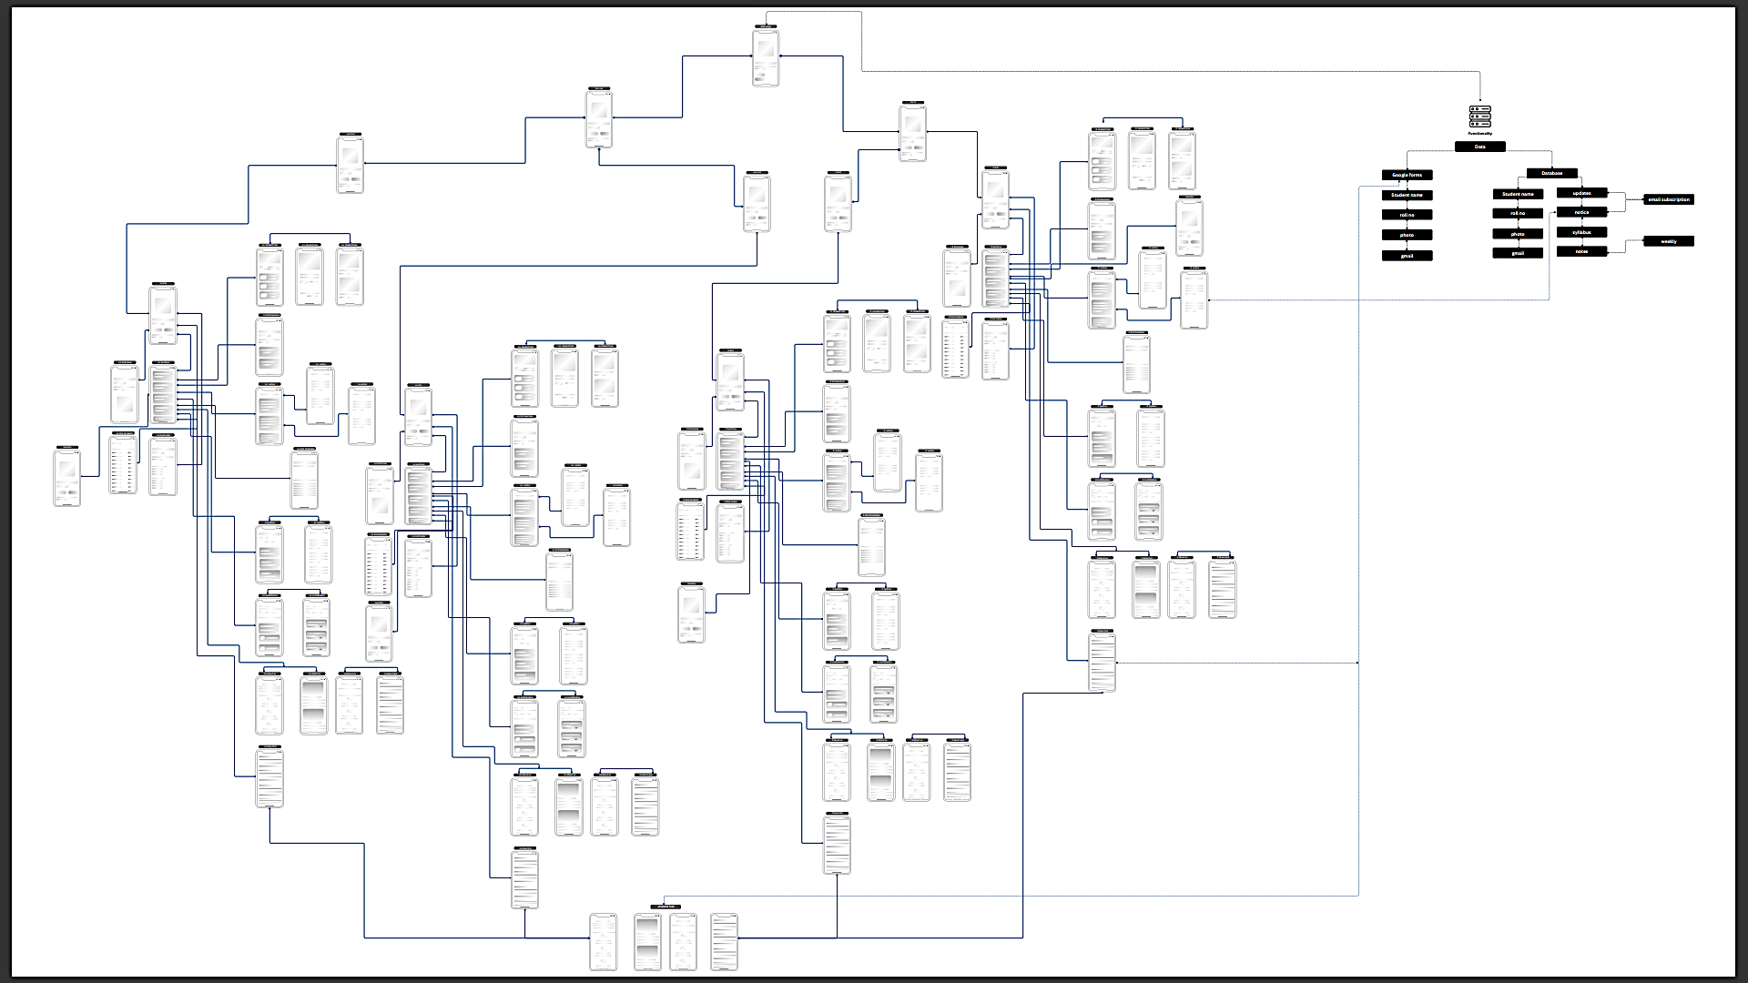
Academic Section Wireframe

Slide 17
Thank you
We're bringing more updates and exciting features to IT Off-Topics!

